Slide 1
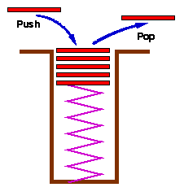
STACKS
Simple but very important data structure
DEFINITION: A stack is a data structure in which all insertions and deletions of entries are made at one end, called the TOP of the stack.
ANALOGY: A stack of trays or plates sitting on the counter in a busy student cafeteria. The tray on the TOP is removed by a customer. Students place returned trays on TOP of the stack.
⇒ Notice that the last tray returned is the first one removed.

Slide 2

Examples of Stacks:
(a) Internet web browsers store the addresses of recently visited sites on a stack. Each time a user visits a new site, that sites address is "pushed" onto the stack of addresses. The browser then allows the user to "pop" back to previously visited sites using the "back" button.
(b) Text editors usually provide an "undo" mechanism that cancels recent editing operations and reverts to former states of a document. This undo operation can be accomplished by keeping text changes in a stack.

Slide 3
‘PUSH’ and ‘POP’
When an item is added to a stack, we say that we PUSH it onto the stack.
(Push operation)
When an item is removed from a stack, we say that we POP it from the stack.
(Pop operation)
L.I.F.O. (Last In, First Out)
The last item pushed onto a stack is always the first that will be popped from the stack. This property is called Last In, First Out.

Slide 4
Example using a stack : Reversing an Array of Integers
Problem Statement: Write a method that will read an array of integer numbers as input and will then write it out backwards.
INPUT ⇒ 1 2 3 4 5
OUTPUT ⇒ 5 4 3 2 1
Solution: As each integer is read, push it onto the stack. When the input is finished, we then pop integers off the stack. They will come off the stack in reverse order.
Pre = Precondition
Post = Postcondition

Slide 5
Pre: The user supplies a set of integers.
Post: The set of integers has been printed backward, using a stack.
public static int[ ] reverseRead(int[ ] a)
{
Stack myStack = new Stack( );
int [ ] b = new int[a.length];
for (int i = 0; i < a.length; i++)
myStack.push(a[i]);
for (int i = 0; i < a.length; i++)
b[i] = (int)(myStack .pop( ));
return b;
}
We will look at this in a full program in more detail later.

Slide 6
Information Hiding
- Use of methods: notice that we have been able to write the method reverseRead without considering how the stack will be implemented (in storage) and before we write the details of the other functions called.
- Alternative Implementations: There are different ways to represent the data in memory. Also, there are several different ways to do the operations. In some applications, one method is better, while in other applications another method proves superior.
- Change of Implementation: As you gain experience, you may change the way you implement the stack. - Contiguous VS Dynamic
- Clarity of Program: Information hiding gives you improved readability.
- Top-down Design: Separating the use of the data structure from it’s implementation.

Slide 7
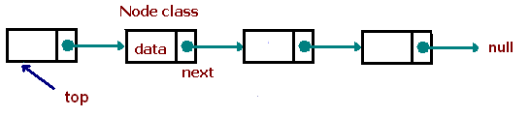
Status
public boolean isEmpty( );
Pre: The stack exists and it has been initialised
Post: Return TRUE if the stack is empty, FALSE otherwise
Stack Class

Slide 8
Fundamental Operations
public void push(Object obj)
Pre: The stack exists and it is not full
Post: The argument newElement has been stored at the top of the stack
public Object pop( )throws StackException
Pre: The stack exists and it is not empty
Post: The top of the stack has been removed and returned.

Slide 9
Other Operations
public void clearStack ( );
Pre: The stack exists and has been initialised.
Post: All entries in the stack have been deleted; the stack is left empty.
public int sizeOfStack ( );
Pre: The stack exists and has been initialised.
Post: The function returns the number of entries in the stack
public int stackTop( );
Pre: The stack exists and has been initialised.
Post: The item at the top of the stack is returned without being removed; the stack remain unchanged.

Slide 10
Interface methods
public int getElement(int index);
Pre: The stack exists and has been initialised.
Post: The method is a simple interface method that allows a value to be retrieved from the stack. Remember it is not correct object-oriented design to allow direct access to the data fields of a class(i.e. hence we make them private), so whenever the value of one of these fields is required, an interface method should be provided.
public int getStackPointer( );
Pre: The stack exists and has been initialised.
Post: The method is a simple interface method that returns the value held in stackPointer – that is the index of the top of the stack.

Slide 11
Implementation Of Stacks - Dynamically Linked Stacks
Stacks & Queues implemented with arrays have a drawback – the size of the array must be fixed in advance.
An alternate implementation is to use a singly linked list of nodes
The ordering of the nodes is the same as in the game “Follow the Leader” in that each node is a compound object that stores that stores a reference to an element and a reference called next to another node.
It might seem like a circular reasoning to have a node reference another node, but this scheme easily works.

Slide 12
Implementation Of Stacks - Dynamically Linked Stacks
View the next reference inside a node as a link OR pointer to another node.
OR
next can be used to tie an object of type Node to another object of the same type.
OR
Use the next reference to “hop” from one node to the next
The order of the nodes is maintained by the chain of next references

Slide 13
Implementing a Stack as a Linked Structure
Allows dynamic allocation of space for each stack element as required.
Therefore a fixed amount of space does not need to be set aside
wasting space if fewer elements are used or
running out of space if more elements are required.
Need to keep a pointer to the top of the stack

Slide 14
top
Data
Implementation Of Stacks - Dynamically Linked Stacks
Data
“This implementation of a Stack allows it to grow and shrink as required within an application”
Data
Data
NULL

Slide 15
Implementation Of Stacks - Dynamic Linked Stacks
First, let’s look at how we will declare a node for our stack…..
public class Node {
private Object element; // element stored in this node
private Node next; // reference to the next node in the list
// Constructors
public Node(Object e, Node n) {
element = e;
next = n;
}

Slide 16
// Update methods
public void setElement(Object newElem)
{ element = newElem; }
public void setNext(Node newNext)
{ next = newNext; }
// Accessor methods
public Object getElement( )
{ return element; }
public Node getNext( )
{ return next; }
} // end of class Node

Slide 17
Now let’s look at some of the operations that will need to use our stack…..These will be in the STACK Class
Status Operation
public boolean isEmpty( ) {
// Returns true if the stack is empty
if (top == null)
return true;
else
return false;
}
top
NULL

Slide 18
Basic Operations
public void push(Object obj) {
//Push a new object on the stack
Node n = new Node();
n.setElement(obj);
n.setNext(top);
top = n;
size++;
}

Slide 19
public Object pop( ) {
// Pop off the top stack element
Object temp;
if (isEmpty( ))
{ System.out.println("Stack is empty."); }
temp = top.getElement( );
top = top.getNext( );
size--;
return temp;
}

Slide 20
Other Operations
public Object top( ) throws StackException {
// Return the top stack element
if (isEmpty( ))
{ System.out.println("Stack is empty."); }
return top.getElement( );
}
//=========================================================
public int size( ) {
// Returns the current stack size
return size;
}

Slide 21
NOW LET’S PUT IT ALL TOGETHER……..
public class Node {
private Object element; // element stored in this node
private Node next; // reference to the next node in the list
// constructors
public Node(Object e, Node n) {
//create a node given element and next reference
element = e;
next = n;
}

Slide 22
// update methods
public void setElement(Object newElem)
{ element = newElem; }
public void setNext(Node newNext)
{ next = newNext; }
// accessor methods
public Object getElement( )
{ return element; }
public Node getNext( )
{ return next; }
} // end of class Node

Slide 23
public class LinkedStack {
private Node top; // reference to the top node
private int size; // number of elements in the stack
public LinkedStack( ) { // Initialize the stack
top = null;
size = 0;
}
public int size( ) {
// Returns the current stack size
return size;
}

Slide 24
public boolean isEmpty( ) {
// Returns true if the stack is empty
if (top == null)
return true;
else
return false;
}
public Object top( ) { // Return the top stack element
if (isEmpty( ))
{ System.out.println("Stack is empty."); }
return top.getElement( );
}

Slide 25
public void push(Object obj) {
// Push a new object on the stack
Node n = new Node( );
n.setElement(obj);
n.setNext(top);
top = n;
size++;
}
public Object pop( ) {
// Pop off the top stack element
Object temp;
if (isEmpty( ))
{ System.out.println("Stack is empty."); }
temp = top.getElement( );
top = top.getNext( ); // adjust the top node
size--;
return temp;
}
}

Slide 26
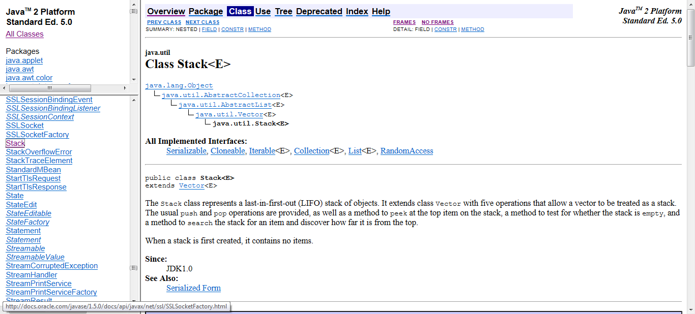
Stacks are so widely used that many languages, including Java, have added a Stack class to the API library

